Slide 1
In His Time
Ecclesiastes 3:1-15
Dr. Rick Griffith • Crossroads International Church Singapore
CICFamily.com • BibleStudyDownloads.org

Slide 2
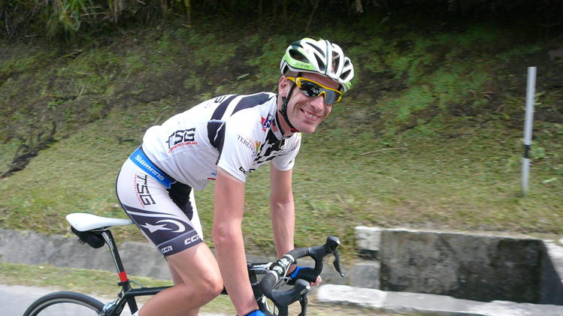
Maarten de Jonge
Notes:
Newser reports that 29-year-old “Maarten de Jonge is a lucky man—two times over. The Dutch cyclist had a ticket for not only [the 17 July 2014] doomed Malaysia Airlines Flight 17, but also the still-missing Malaysia Airlines Flight 370. Both times, ABC News reports, de Jonge changed his flight at the last minute… Like the rest of us, he lives ignorant of his time to die. I wonder if he’s thinking about this now!

Slide 3
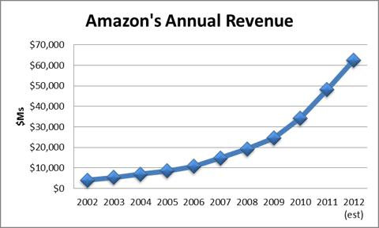
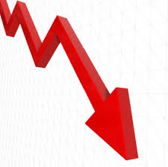
Amazon's Annual Revenue
Notes:
Amazon lost 10% of its share price on Friday. If you knew this was going to happen on Thursday and you had $100,000 in Amazon shares, what would you have done? We all make investment decisions based on incomplete knowledge of God’s timing.
Of course, none of us know the right time for anything—when to change a flight, buy or sell, how long to wait. We all make decisions based on incomplete information.

Slide 4
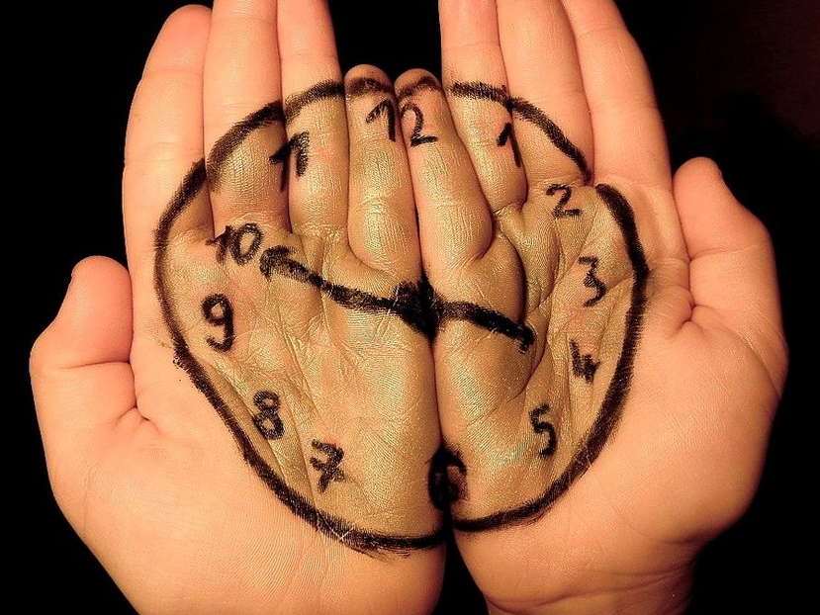
What are you waiting for?

Slide 5
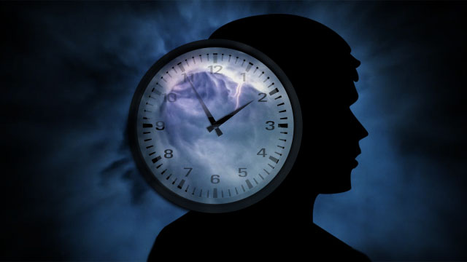
Are you waiting for someone you care about to trust Christ?

Slide 6
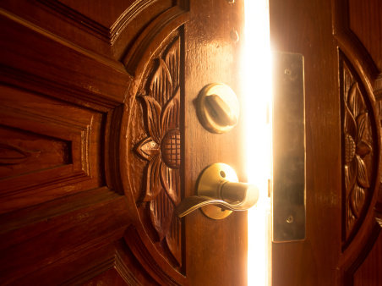
Are you waiting for God to open a door for you—for a job, for a house, for some other opportunity?

Slide 7
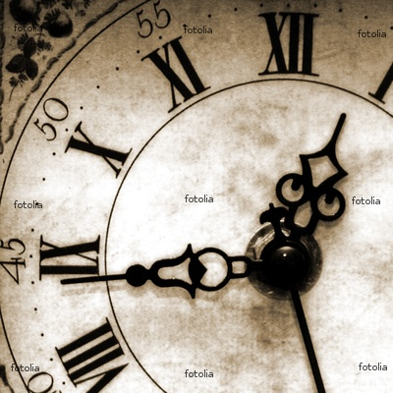
How many of us are waiting for something?

Slide 8
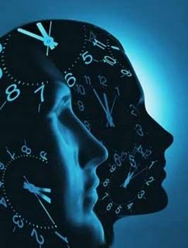
How do you live when you don't know God's timing?

Slide 9
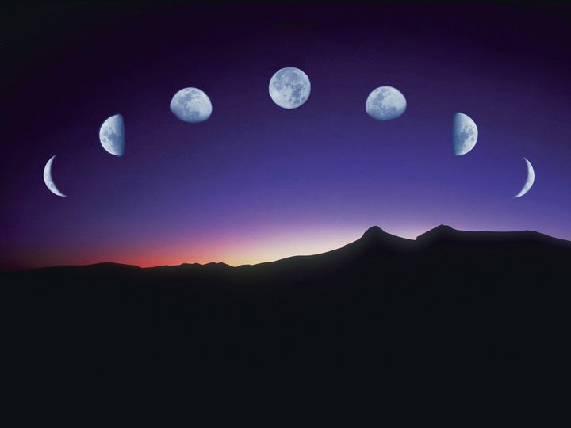
Our Study in Ecclesiastes
Work & Wisdom Don't Last

Slide 10
Where we're going today…
Two ways God is perfect
How to respond

Slide 11
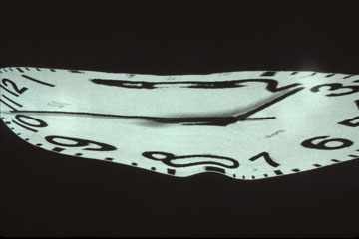
God is perfect in that…
Ecclesiastes 3:1-15

Slide 12
I. God's timing is perfect (3:1-8).
Notes:
He causes events at the flawless moment!

Slide 13
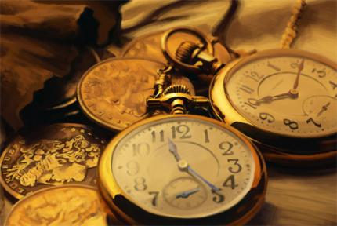
The Thesis: Every activity has its appointed time (3:1)

Slide 14
Ecclesiastes 3:1a (NIV)
"There is a time for everything…"

Slide 15
"…and a season for every activity under heaven" (3:1b NIV).

Slide 16
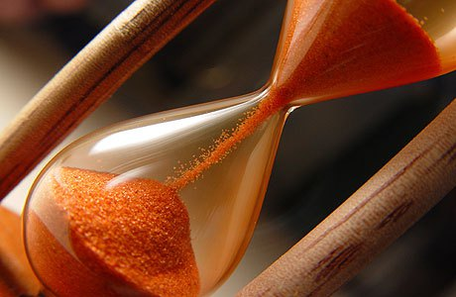
"season" (NET Bible notes)
"the appointed or designated time for the Jewish feasts (Esth. 9:27, 31) [and] the length of time that Nehemiah set for his absence from Susa (Neh. 2:6)."

Slide 17
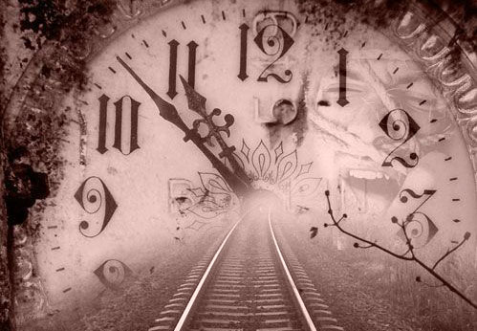
The Proof: God has perfect timing in every activity (3:2-8).

Slide 18
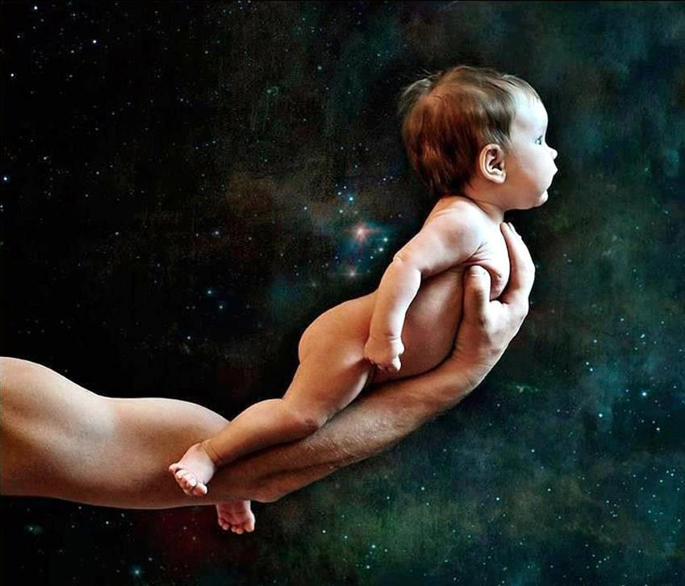
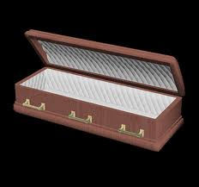
"A time to be born…
and a time to die" (3:2a)

Slide 19
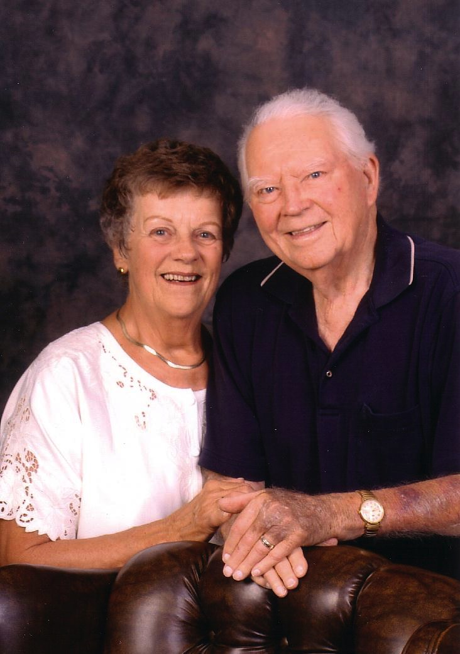
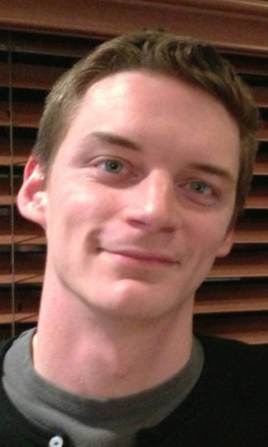
Susan's Parents
Kurt & Doris

Slide 20
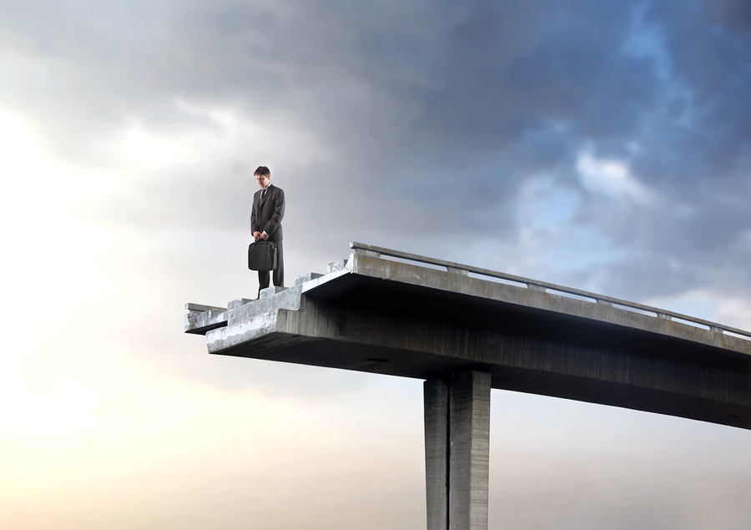
"…and in Your book were all written the days that were ordained for me, when as yet there was not one of them" (Ps. 139:16b NAU).

Slide 21
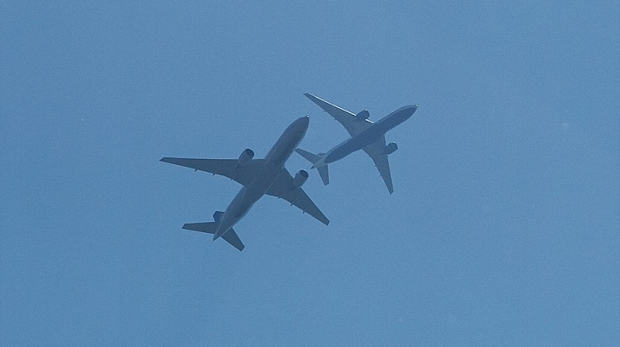
Two flights, same destination
Notes:
When will you die? None of us knows! My wife and I had friends with four teenagers who fear an airplane accident that could kill them both. So Danny and Becky never fly together. They go to the airport together, take separate flights to their destination (they live in Hungary), and meet up at the airport on the other end. Makes sense, right? They see this as being responsible before God as parents.
The rest of us don’t know any more than Danny and Becky. I can’t predict which plane will crash or which car will spin out of control on the way to the airport—which, I hear, is more dangerous than taking a flight, by the way!

Slide 22
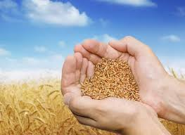
"A time to plant…
and a time to harvest" (3:2b)

Slide 23
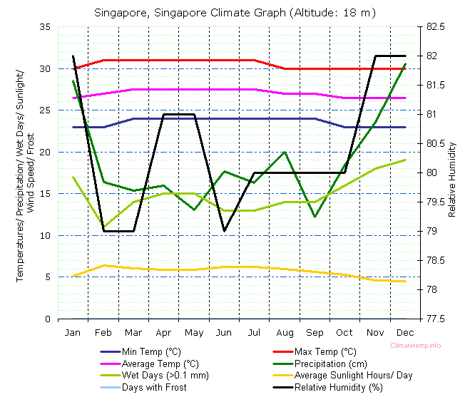
Singapore "Seasons"
http://misfitsarchitecture.com/2013/03/08/its-not-rocket-science-7-evapo-transpiration/
Notes:
http://misfitsarchitecture.com/2013/03/08/its-not-rocket-science-7-evapo-transpiration/

Slide 24
"A time to plant…
and a time to harvest" (3:2b)

Slide 25
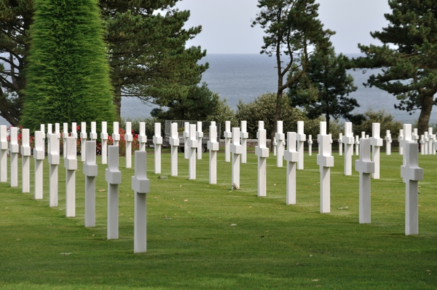
"A time to kill…
and a time to heal" (3:3a)

Slide 26
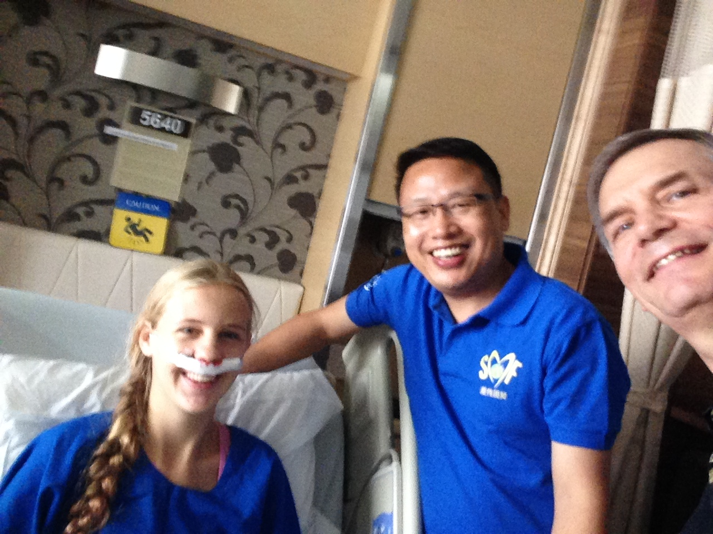
Time to heal

Slide 27
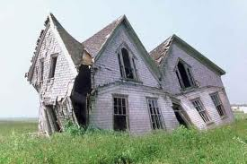
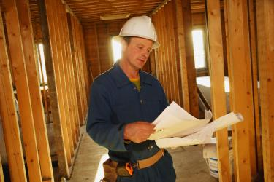
"A time to tear down…
and a time to build up" (3:3b)

Slide 28
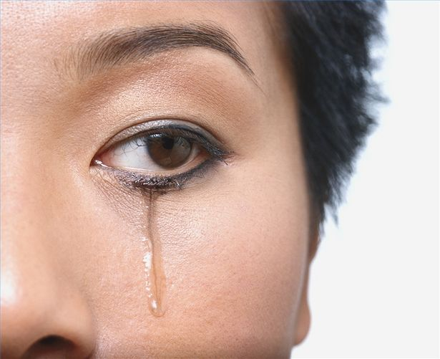
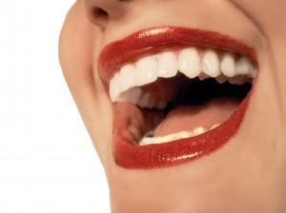
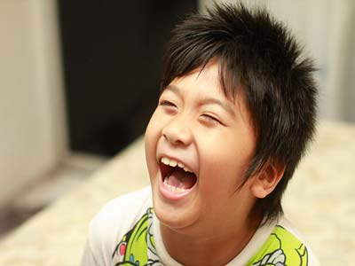
"A time to cry…
and a time to laugh" (3:4a)

Slide 29
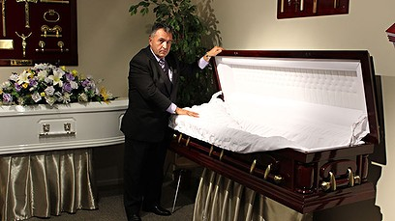
Funeral Director
Notes:
I love laughter! Swindoll writes, “I heard about a pastor who left the pastorate after 20 years. He decided to become a funeral director. Somebody asked, ‘Why did you do that?’ He answered: ‘Well, I spent about 12 years trying to straighten out John. He never did get straightened out. I spent 14 months trying to straighten out the marriage of the Smith’s, and it never did get straightened out. I spent three years trying to straighten out Susan, and she never did get straightened out. Now when I straighten them out, they stay straight” (Living on the Ragged Edge, 72)

Slide 30
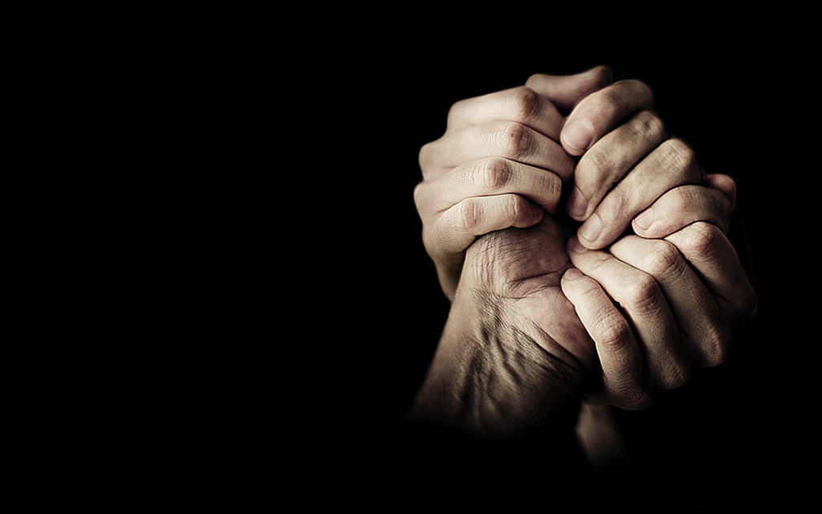
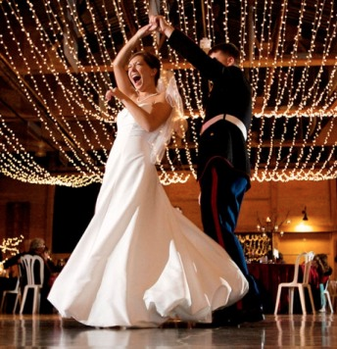
"A time to grieve…
and a time to dance" (3:4b)

Slide 31
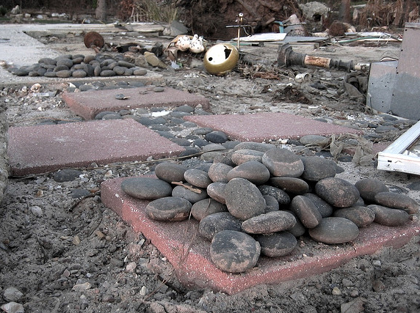
"A time to scatter stones…
and a time to gather stones" (3:5a)

Slide 32
Stones of Remembrance
Today we recall six years of God's faithfulness to Crossroads

Slide 33
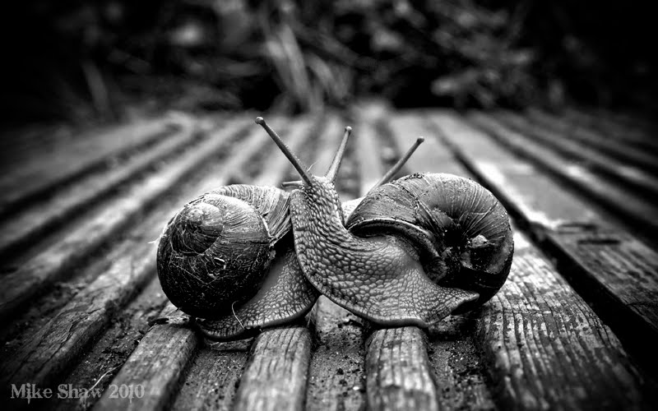
"A time to embrace…
and a time to turn away" (3:5b)

Slide 34
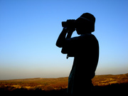
"A time to search…
and a time to quit searching" (3:6a)

Slide 35
The Ant and the Contact Lens
Notes:
“Brenda was a young woman who was invited to go rock climbing. Although she was very scared, she went with her group to a tremendous granite cliff. In spite of her fear, she put on the gear, took hold of the rope, and started up the face of the rock.
Well, she got to a ledge where she could take a breather. As she was resting there, the safety rope snapped against Brenda’s eye and knocked out her contact lens.
There she was, on a rock ledge, with hundreds of feet below her and hundreds of feet above her. Of course, she looked and looked and looked, hoping her contact lens had landed on the ledge, but it was just not there.
• Here she was, far from home, her sight was now blurry. Brenda was desperate and began to get upset. She prayed to the Lord to help her to find it. When she got to the top, a friend examined her eye and her clothing for the lens, but there was no contact lens to be found.

Slide 36
“For the eyes of the LORD move to and fro throughout the earth that He may strongly support those whose heart is completely His” (2 Chron. 16:9 NAU).
Notes:
Despondent, she sat down with some of the party waiting for them to make it up the face of the cliff. She looked out across the range of mountains and thought of the Bible verse that said: “For the eyes of the Lord run to and fro throughout the whole earth …” (2 Chronicles 16:9).
She thought “Lord, you can see these mountains. You know every stone and leaf and you know exactly where my contact lens is. Please help me. Finally, she walked down the trail to the bottom. A new party of climbers was just starting up the face of the cliff. One of them shouted out: “Hey guys! Anybody lose a contact lens?”

Slide 37
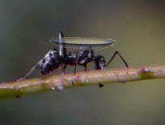
The Ant and the Contact Lens
Notes:
Well, that would be startling enough, but do you know where the climber saw it? An ant was moving slowly across the face of the rock, carrying it on his back. The story gets better. Brenda’s father is a cartoonist.

Slide 38
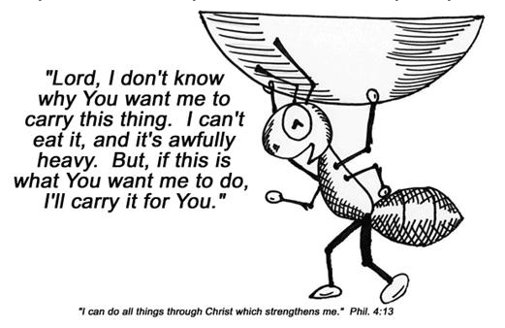
"Lord, I don't know why You want me to carry this thing. I can't eat it, and it's awfully heavy. But, if this is what You want me to do, I'll carry it for You."
"I can do all things through Christ who strengthens me" (Phil. 4:13)
Notes:
When she told him the incredible story of the ant, her prayer and the contact lens, he drew a picture of an ant lugging that contact lens with the words: “Lord, I don’t know why you want me to carry this thing. I can’t eat it, and it’s awfully heavy. But if that’s what you want me to do, I’ll carry it for you.”

Slide 39
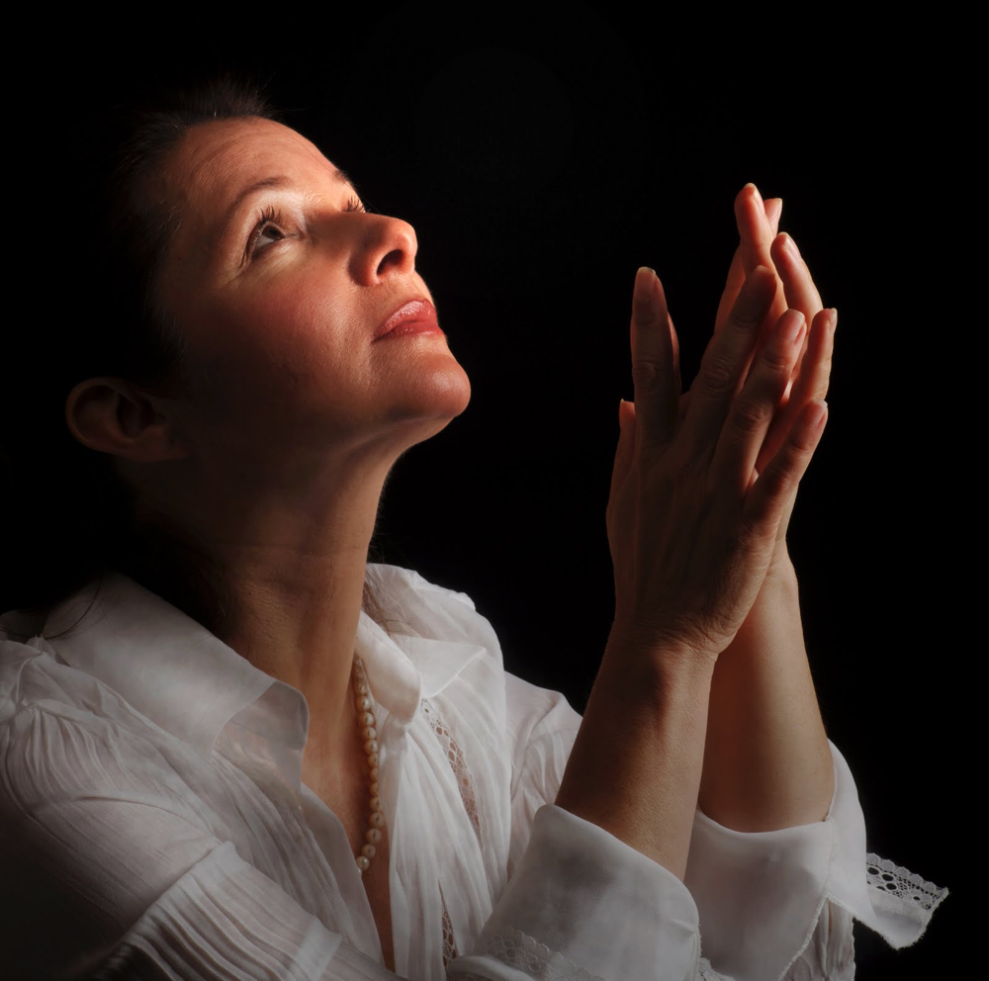
The Ant and the Contact Lens
Notes:
I think it would do some of us good to occasionally say, "God, I don't know why you want me to carry this load. I can't see any good in it and it's awfully heavy. But if you want me to carry it, I will."
You see, we all have a burden to carry and sometimes we don't know why. It could be just because we are to be an example to someone else or by answered prayer by being humble before God."
"For everything there is a season, a time for every activity under heaven… a time to search and a time to give up as lost" (3:1, 6a NAU).
Are you still searching? Is it time just to give it over the to Lord and even let an ant bring it to you in his good time if God wills it?

Slide 40
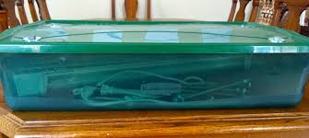
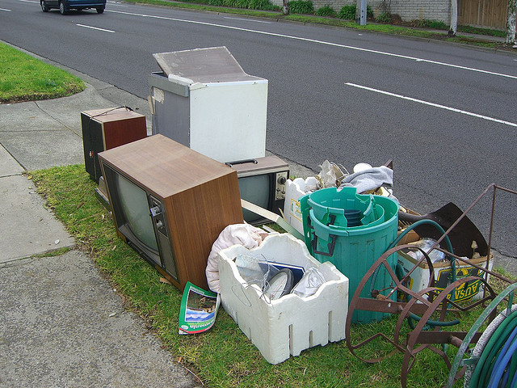
"A time to keep…
and a time to throw away" (3:6b)

Slide 41
"A time to tear…
and a time to mend" (3:7a)

Slide 42
"A time to be quiet…
and a time to speak" (3:7b)

Slide 43
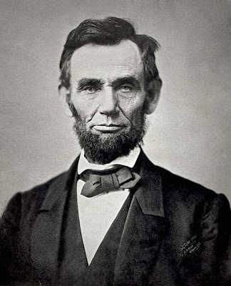
Abraham Lincoln (1809-1865)
"When he had nothing to say, he said nothing."

Slide 44
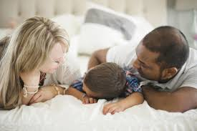
"A time to love…
and a time to hate" (3:8a)

Slide 45
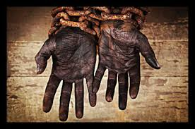
Abraham Lincoln (1809-1865)
"There was a rising hatred inside of me against slavery, and I swore if someday I could do something about it, I would do something about it ."
Notes:
The first time young Abraham Lincoln saw a slave for sale on the block, he recoiled within. He said, “There was a rising hatred inside of me against slavery, and I swore if someday I could do something about it, I would do something about it.” He hated slavery with a passion! There’s a time to hate, there’s a time to love (Swindoll, 76).

Slide 46
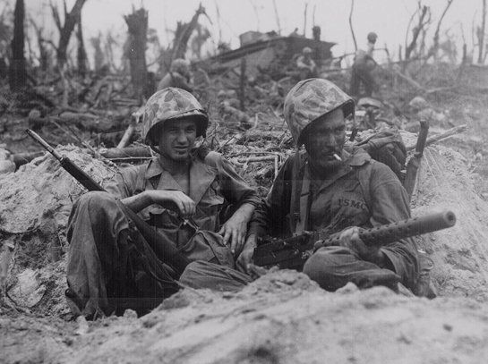
"A time for war…
and a time for peace" (3:8b)

Slide 47
I. God's timing is perfect (3:1-8).
Notes:
He causes events at the flawless moment!

Slide 48
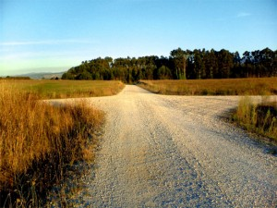
II. God's ways are perfect (3:9-11).
Notes:
Our best has limited success but God does everything right.

Slide 49
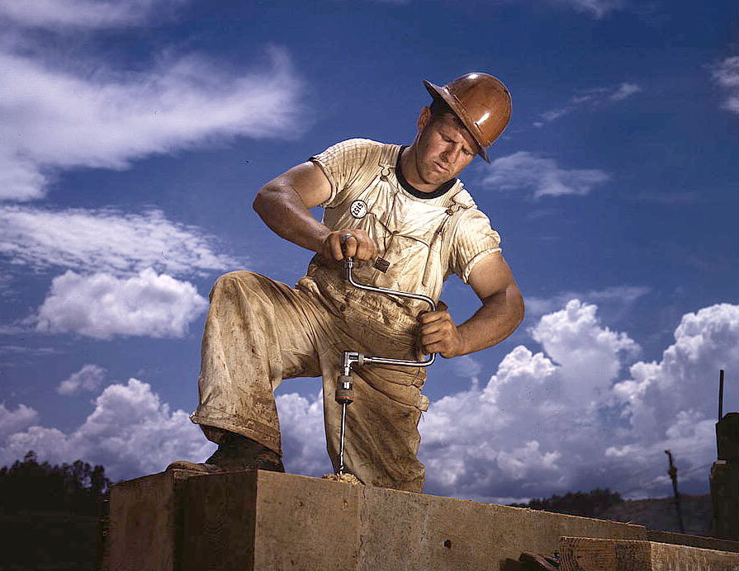
"What do people really get for all their hard work?" (3:9 NLT)

Slide 50
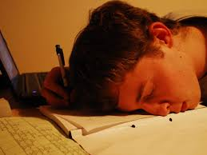
"I have seen the burden God has placed on us all" (3:10 NLT).
"I have seen the task which God has given the sons of men with which to occupy themselves" (3:10 NAU).

Slide 51
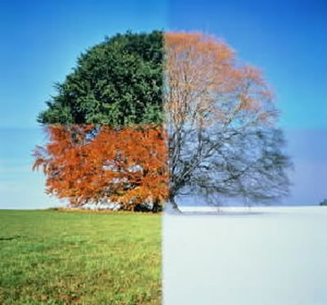
"Yet God has made everything beautiful* for its own time" (3:11a NLT)
* "appropriate" (NAU), "fitting" (5:18)
Notes:
The Hebrew reads literally "beautiful" but

Slide 52
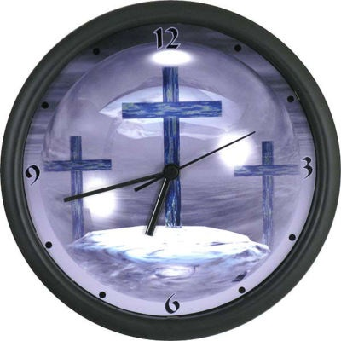
In His Time Diane Ball (based on Ecclesiastes 3:11) CCLI Song # 25981 © 1978 CCCM Music (Admin. by Maranatha! Music (Capitol CMG)) CCLI Licence # 277507

Slide 53
In His time, in His time. He makes all things beautiful, In His time.

Slide 54
Lord, please show me every day As You're teaching me Your way That You do just what You say In Your time.

Slide 55
In Your time, in Your time. You make all things beautiful, In Your time.

Slide 56
Lord, my life to You I bring. May each song I have to sing Be to You a lovely thing In Your time.

Slide 57
"He has planted eternity in the human heart…" (3:11b NLT).
Notes:
God has placed a longing in man to know how he and his activities relate to eternity (3:11b).

Slide 58
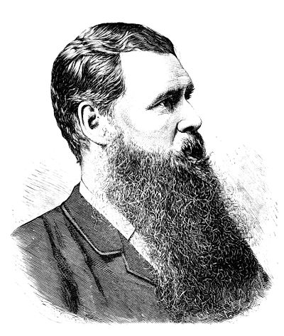
Edward B. Tylor ("the father of anthropology")
Notes:
Don Richardson records in his book Eternity in Their Hearts, that Lenin and Marx thought the work of Edward B. Tylor (“the father of anthropology”) would finally destroy religion. Tylor wanted to show that belief in God was not innate but foisted upon us by the religionists. Richardson writes…
“The theory, according to scientific procedure, needed to be tested and confirmed by anthropological field research. (cover flap)

Slide 59
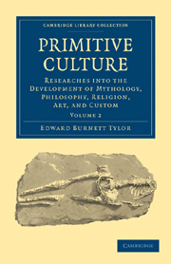
Edward B. Tylor ("the father of anthropology")
Notes:
“So, around the turn of the century, scores of young anthropologists fanned out around the globe for that very purpose. Expecting to find that ‘primitive’ cultures were uniformly devoid of monotheistic beliefs, they were shocked to discover hundreds of examples of belief in one true God!

Slide 60
Don Richardson
Notes:
“In a fascinating series of documented stories, from the Santal people in India to the educated philosophers of ancient Athens, Don Richardson relates incredible examples of how the concept of a supreme God has existed for centuries in hundreds of cultures throughout the world.”

Slide 61
"He has planted eternity in the human heart, but even so, people cannot see the whole scope of God's work from beginning to end" (3:11b-c NLT).
Notes:
God reserves the right to withhold His sovereign, eternal plan from man's knowledge (3:11c).

Slide 62
Children are fascinated with eternity

Slide 63
I. God's timing is perfect (3:1-8).
Notes:
He causes events at the flawless moment!

Slide 64
II. God's ways are perfect (3:9-11).
Notes:
Our best has limited success but God does everything right.

Slide 65
III. Enjoy life and fear God (3:12-15).
Notes:
Appreciate your livelihood and stand in awe of the LORD.

Slide 66
Enjoy the money you earn as God's gift to you!

Slide 67
"So I concluded there is nothing better than to be happy and enjoy ourselves as long as we can" (3:12 NLT).

Slide 68
"And people should eat and drink and enjoy the fruits of their labor, for these are gifts from God" (3:13 NLT).
Enjoy the money you earn as God's gift to you

Slide 69
Great Advice!
LIVE WELL
LAUGH OFTEN
LOVE MUCH
Notes:
Do people feel sorry for you?
I want to live in such a way that people are attracted to Jesus by looking at my life!

Slide 70
"I know that everything God does will remain forever" (3:14 NAU).
Notes:
The NLT is the only major translation to render this “And I know that whatever God does is final.” This is not the sense of the Hebrew o’lam, which means “eternal, everlasting” (BDB).

Slide 71
"Nothing can be added to it or taken from it. God's purpose is that people should fear him" (3:14b NLT).

Slide 72
"What is happening now has happened before, and what will happen in the future has happened before, because God makes the same things happen over and over again" (3:15 NLT).

Slide 73
How can we sum up this passage in a sentence?

Slide 74
Main Idea
Celebrate your ignorance of God's timing.

Slide 75
Key Ideas
God's timing is perfect (3:1-8).
God's ways are perfect (3:9-11).
Enjoy life and fear God (3:12-15).

Slide 76
What are you waiting for? Rest in God's perfect time for it!

Slide 77
God controls time, so wait on his timing for you.

Slide 78
Memorize 3:1
"There is an appointed time for everything. And there is a time for every event under heaven" (NAU).

Slide 79
Journal

Slide 80
The night before my wedding…
Notes:
The night before my wedding, my best friend Albert asked me if I was sure that it was God’s will that I get married. I told him, “No… I have heard stories of either the bride or groom getting killed in a car accident on the way to their wedding! But I will be sure tomorrow night that God wants me to stay married! And he will want me to make the best of it and serve Him.”

Slide 81
What time is it?
Time to come to terms with eternity

Slide 82
Admit your mortality

Slide 84
OT Preaching link at BibleStudyDownloads.org
Get this presentation and script for free!

